Slide 1
Wavelet Transform
A very brief look

Slide 2
Wavelets vs. Fourier Transform
In Fourier transform (FT) we represent a signal in terms of sinusoids
FT provides a signal which is localized only in the frequency domain
It does not give any information of the signal in the time domain

Slide 3
Wavelets vs. Fourier Transform
Basis functions of the wavelet transform (WT) are small waves located in different times
They are obtained using scaling and translation of a scaling function and wavelet function
Therefore, the WT is localized in both time and frequency

Slide 4
Wavelets vs. Fourier Transform
In addition, the WT provides a multiresolution system
Multiresolution is useful in several applications
For instance, image communications and image data base are such applications

Slide 5
Wavelets vs. Fourier Transform
If a signal has a discontinuity, FT produces many coefficients with large magnitude (significant coefficients)
But WT generates a few significant coefficients around the discontinuity
Nonlinear approximation is a method to benchmark the approximation power of a transform

Slide 6
Wavelets vs. Fourier Transform
In nonlinear approximation we keep only a few significant coefficients of a signal and set the rest to zero
Then we reconstruct the signal using the significant coefficients
WT produces a few significant coefficients for the signals with discontinuities
Thus, we obtain better results for WT nonlinear approximation when compared with the FT

Slide 7
Wavelets vs. Fourier Transform
Most natural signals are smooth with a few discontinuities (are piece-wise smooth)
Speech and natural images are such signals
Hence, WT has better capability for representing these signal when compared with the FT
Good nonlinear approximation results in efficiency in several applications such as compression and denoising

Slide 8

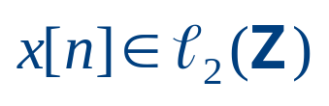

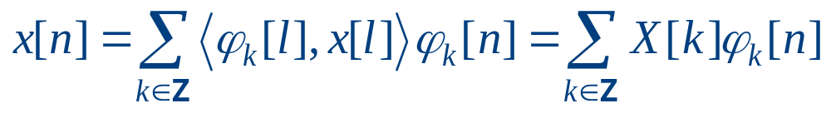
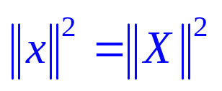
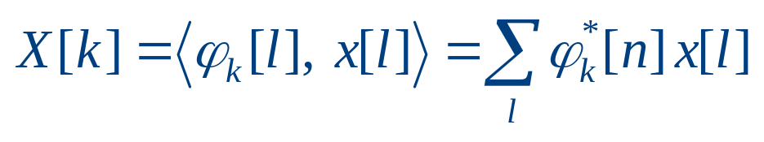

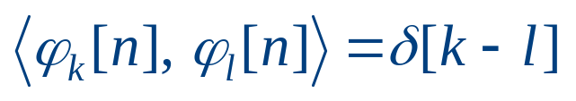
Series Expansion of Discrete-Time Signals
Suppose that is a square-summable sequence, that is
Orthonormal expansion of is of the form
Where
is the transform of
The basis functions satisfy the orthonormality constraint

Slide 9
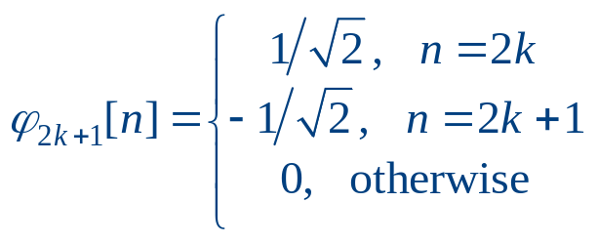
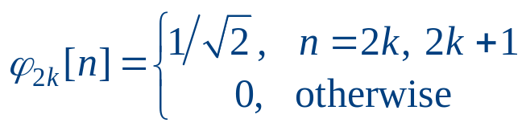
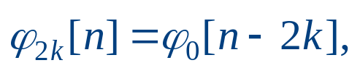
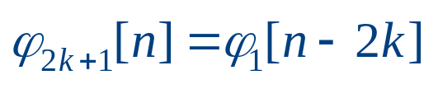
Haar Basis
Haar expansion is a two-point avarage and difference operation
The basis functions are given as
It follows that

Slide 10
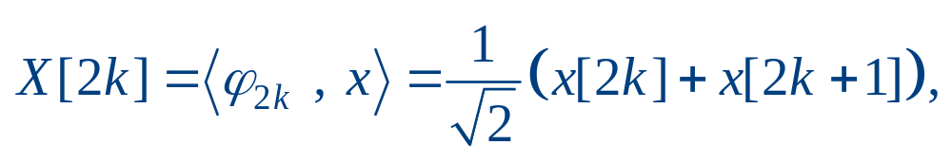
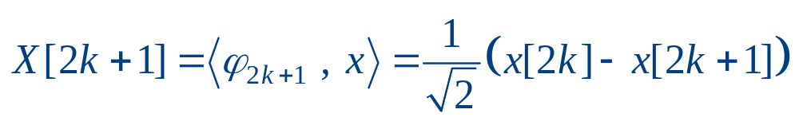
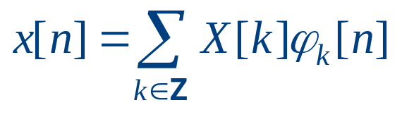
Haar Basis
The transform is
The reconstruction is obtained from

Slide 11
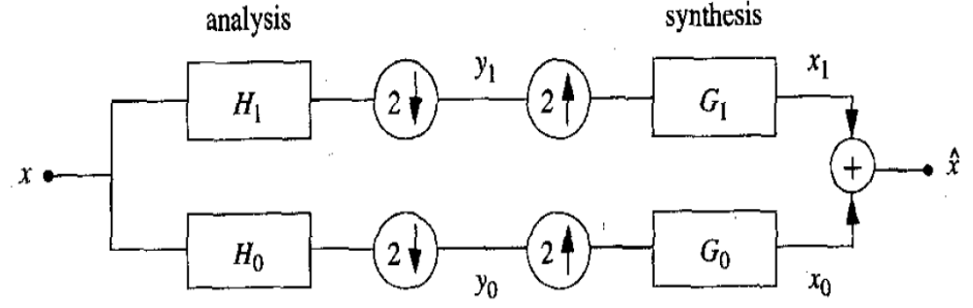
Two-Channel Filter Banks
Filter bank is the building block of discrete-time wavelet transform
For 1-D signals, two-channel filter bank is depicted below

Slide 12
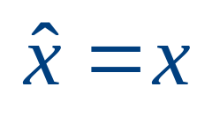
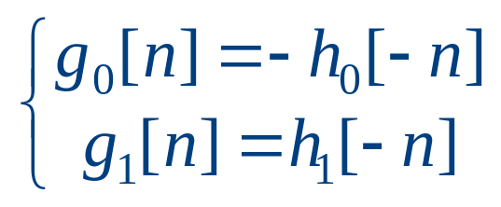
Two-Channel Filter Banks
For perfect reconstruction filter banks we have
In order to achieve perfect reconstruction the filters should satisfy
Thus if one filter is lowpass, the other one will be highpass

Slide 13
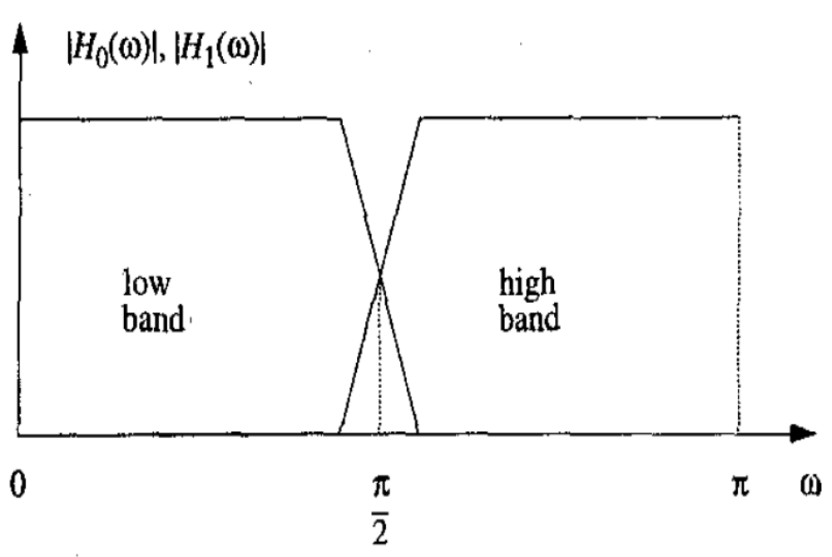
Two-Channel Filter Banks

Slide 14
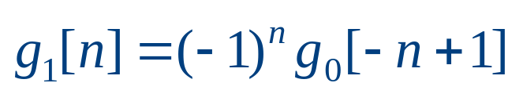
Two-Channel Filter Banks
To have orthogonal wavelets, the filter bank should be orthogonal
The orthogonal condition for 1-D two-channel filter banks is
Given one of the filters of the orthogonal filter bank, we can obtain the rest of the filters

Slide 15
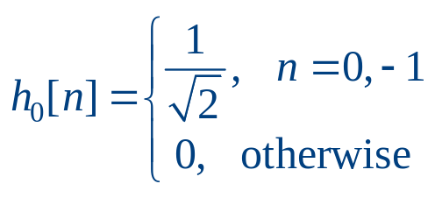
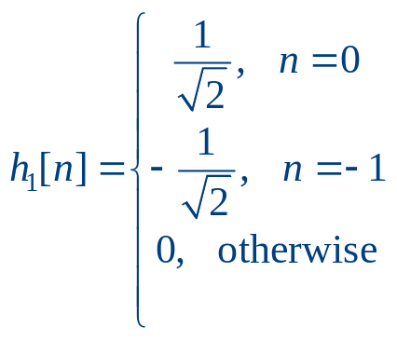
Haar Filter Bank
The simplest orthogonal filter bank is Haar
The lowpass filter is
And the highpass filter

Slide 16
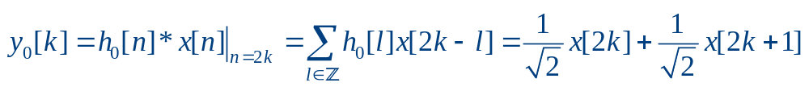
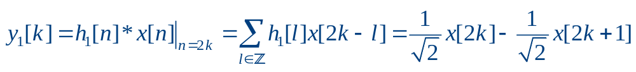
Haar Filter Bank
The lowpass output is
And the highpass output is

Slide 17
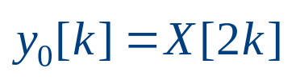
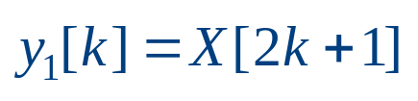
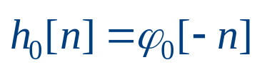
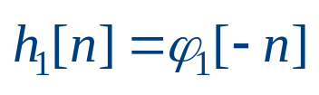
Haar Filter Bank
Since and , the filter bank implements Haar expansion
Note that the analysis filters are time-reversed versions of the basis functions
since convolution is an inner product followed by time-reversal

Slide 18
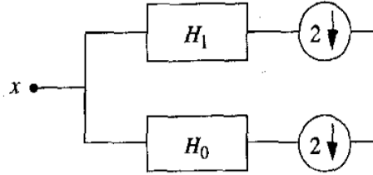
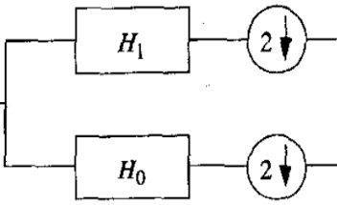
Discrete Wavelet Transform
We can construct discrete WT via iterated (octave-band) filter banks
The analysis section is illustrated below
Level 1
Level 2
Level J

Slide 19



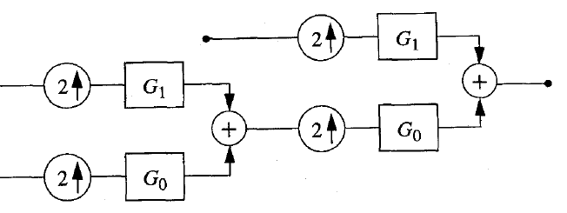






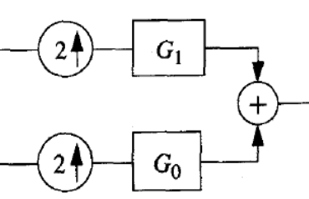

Discrete Wavelet Transform
And the synthesis section is illustrated here
If is an orthogonal filter and , then we have an orthogonal wavelet transform

Slide 20

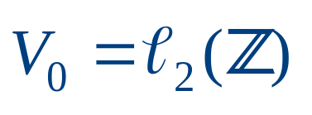

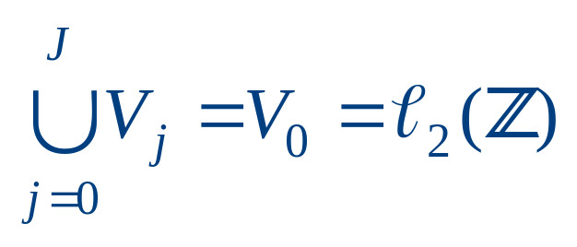
Multiresolution
We say that is the space of all square-summable sequences if
Then a multiresolution analysis consists of a sequence of embedded closed spaces
It is obvious that

Slide 21
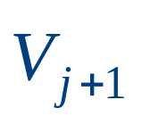

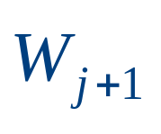
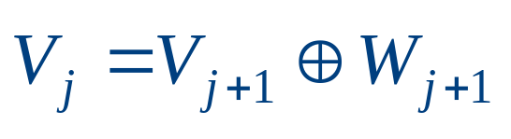
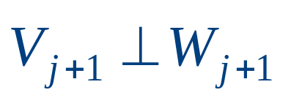


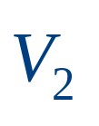
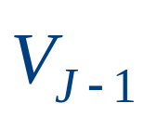
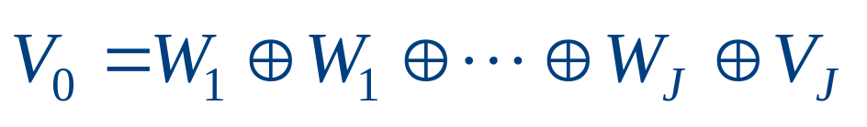
Multiresolution
The orthogonal component of in will be denoted by :
If we split and repeat on , , …., , we have

Slide 22
2-D Separable WT
For images we use separable WT
First we apply a 1-D filter bank to the rows of the image
Then we apply same transform to the columns of each channel of the result
Therefore, we obtain 3 highpass channels corresponding to vertical, horizontal, and diagonal, and one approximation image
We can iterate the above procedure on the lowpass channel

Slide 23
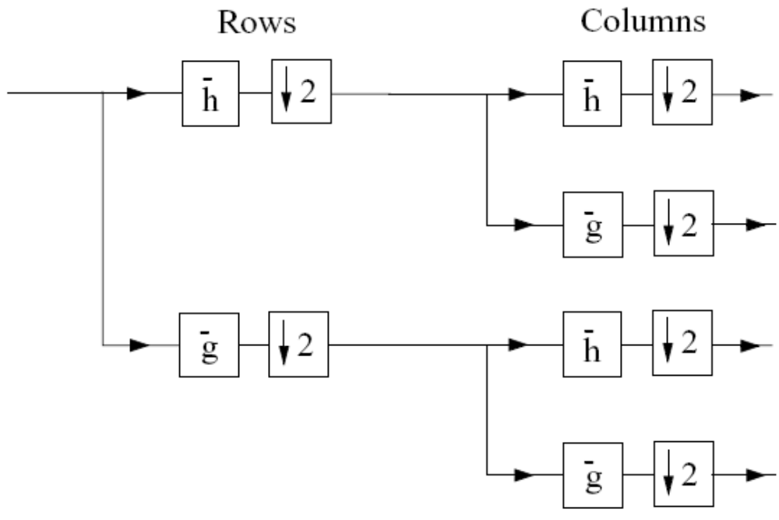



2-D Analysis Filter Bank
diagonal
vertical
horizontal
approximation

Slide 24
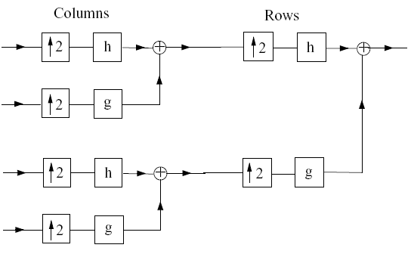



2-D Synthesis Filter Bank
diagonal
vertical
horizontal
approximation

Slide 25
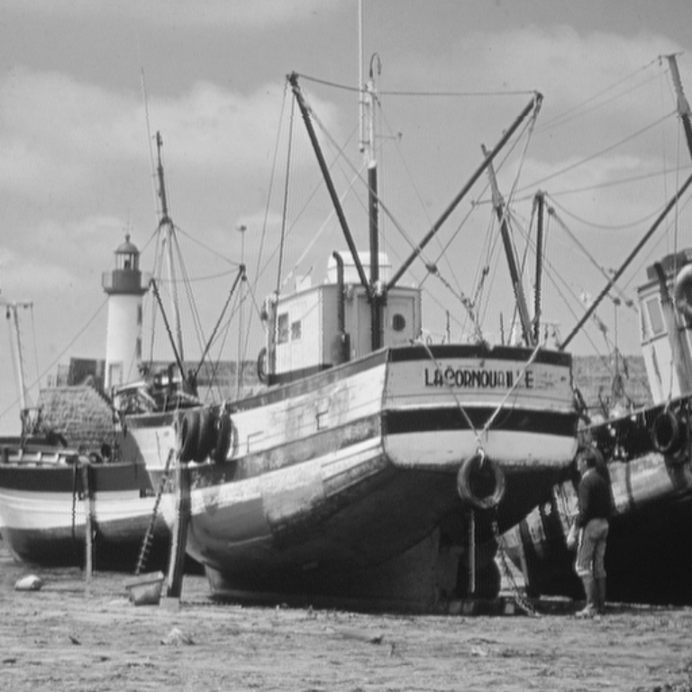
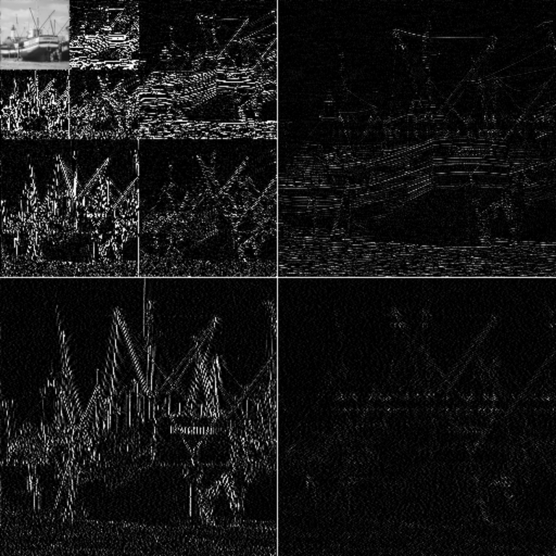
2-D WT Example
Boats image
WT in 3 levels

Slide 26
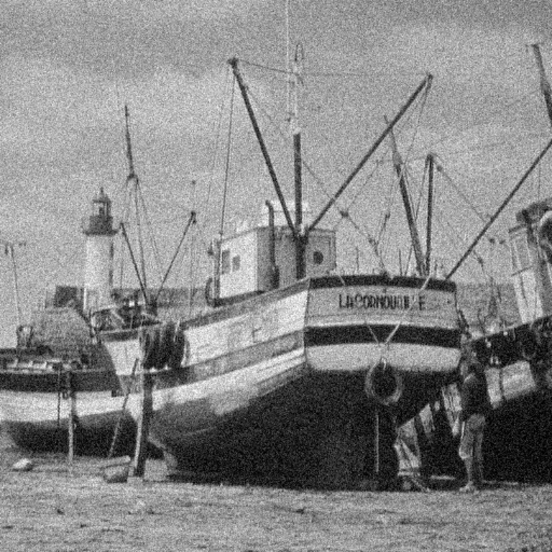
WT-Application in Denoising
Boats image
Noisy image (additive Gaussian noise)

Slide 27

WT-Application in Denoising
Boats image
Denoised image using hard thresholding

Slide 28
Reference
Martin Vetterli and Jelena Kovacevic, Wavelets and Subband Coding. Prentice Hall, 1995.

